Slide 1
College Bazaar
Kelly Weber, James Moir, Patrick Isho, Trevor Drozd, Spenser Grzadzinski, Alissa Barnard

Slide 2
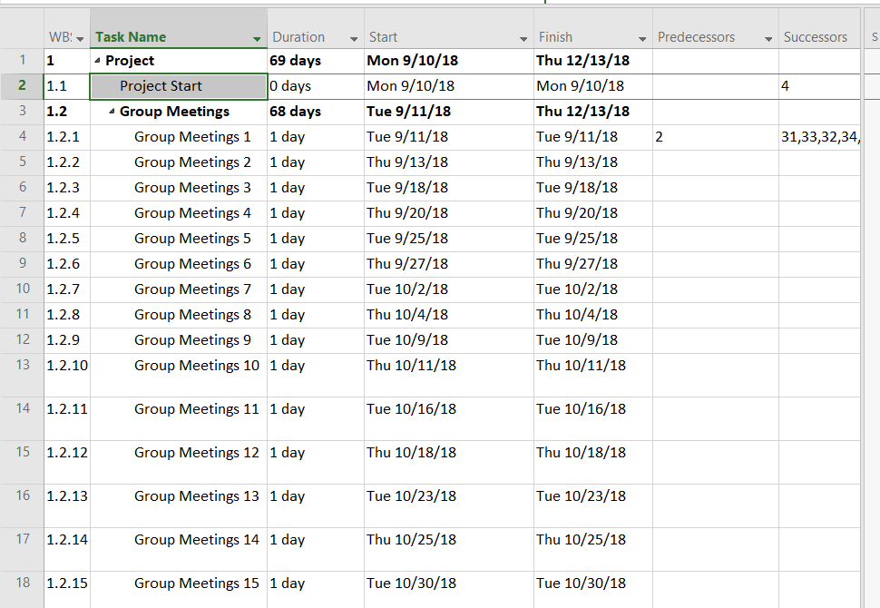
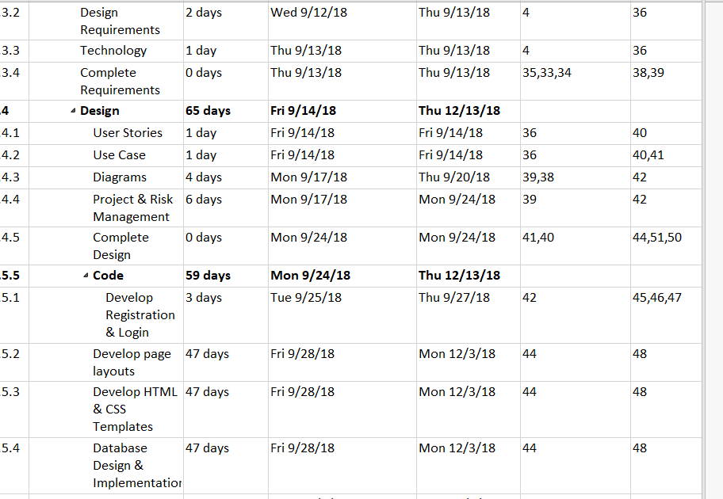
MICROSOFT PROJECT

Slide 3
USER STORIES
User Story #1. As a user I can register on the website to become a subscriber, and I can trust that my registration information shall be stored in a database.
User Story #2. As a user I can login to the website.
User Story #3. As an administrator I shall be able to login with administrator privileges.
User Story #4. As a user I shall have the ability to post and remove products, services, and comments in forums to the website.
User Story #5. As a user I shall have the ability to purchase products and services posted on the website.

Slide 4
USER STORY..cont.
User Story #6. As an administrator I shall be able to depend that the data posted to the website will be stored in the database.
User Story #7. As a user I should have security of my password stored into the database.
User Story #8. As an administrator I should have the ability to view website analytics of the website.
User Story #9. As a website administrator I should have a work environment separate from a live environment.
User Story #10. As an administrator I want the website to provide a legal section and terms of use.
User Story #11. As an administrator I want the website to provide GCP VMs only accessible via console or SSL connection.

Slide 5
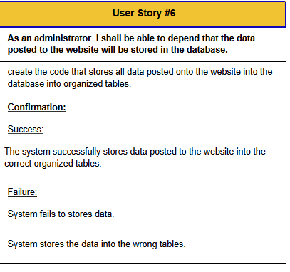
USER STORY DESCRIPTION

Slide 6
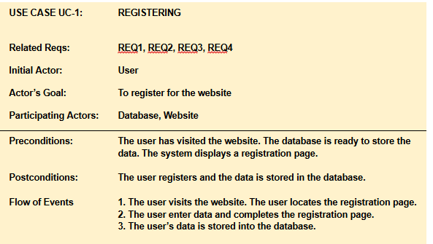
USE CASE DESCRIPTION

Slide 7
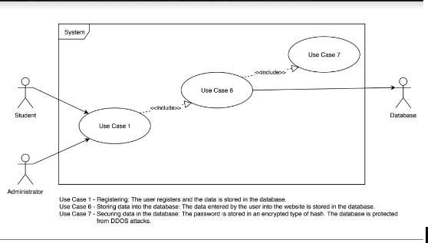
USE CASE DIAGRAM

Slide 8
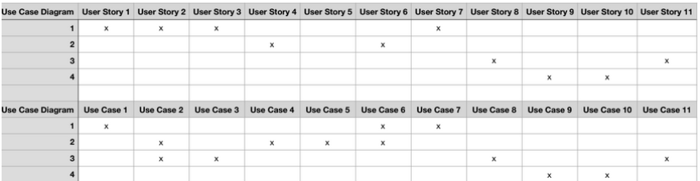
USER STORY/USE CASE MAPPING

Slide 9
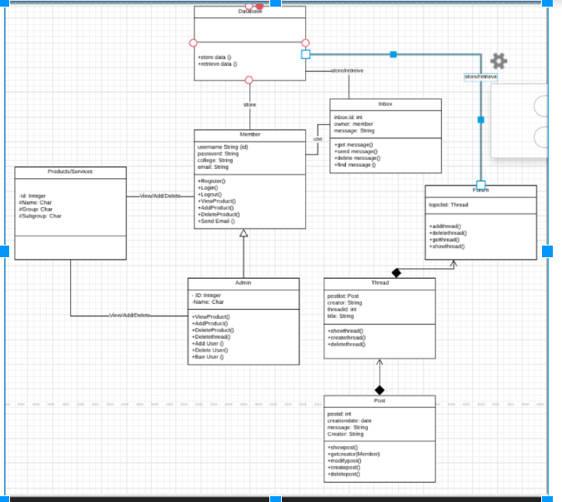

Slide 10
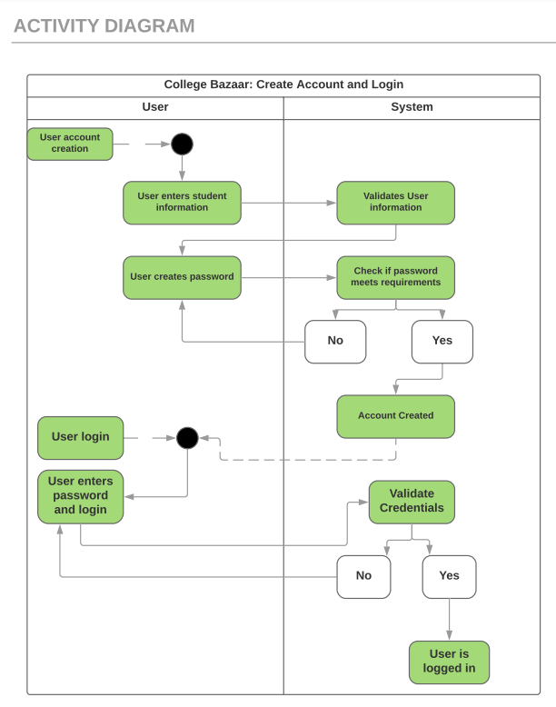
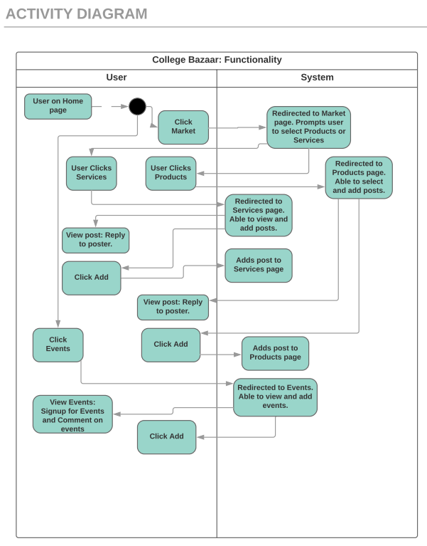

Slide 11
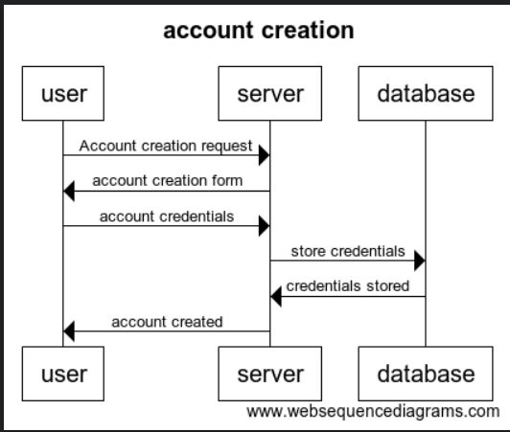

Slide 12
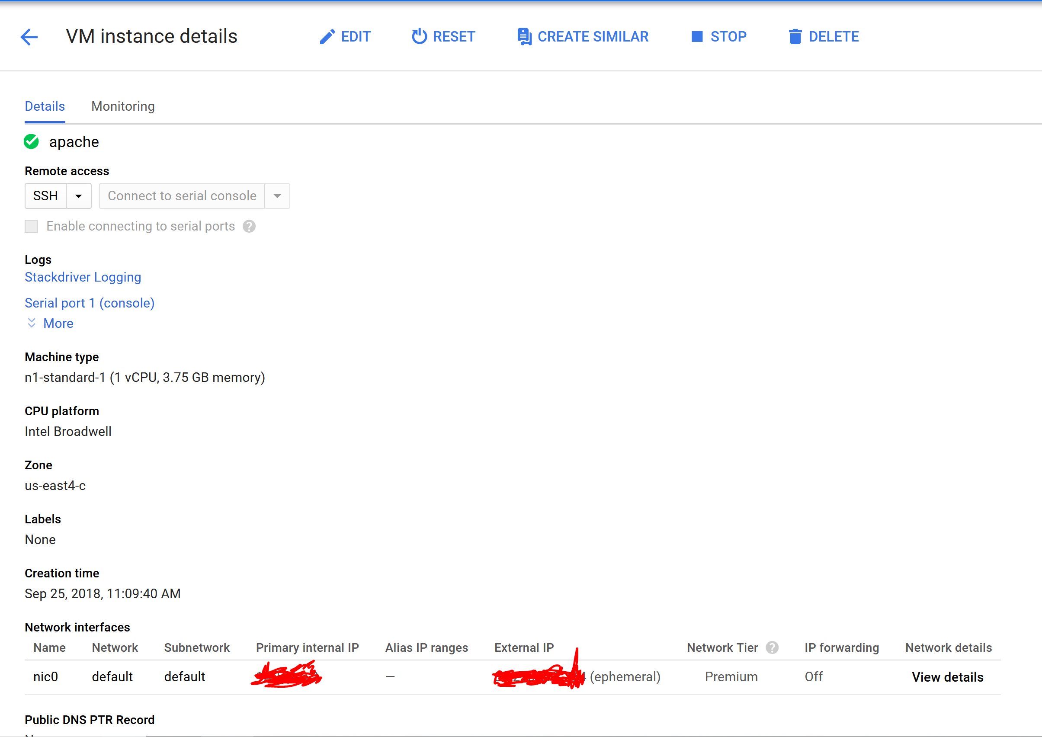
Backend Developments
Debian 9 VM has been installed and is in the process of configuration
20GB dynamic memory and expandable
Located in google east servers

Slide 13
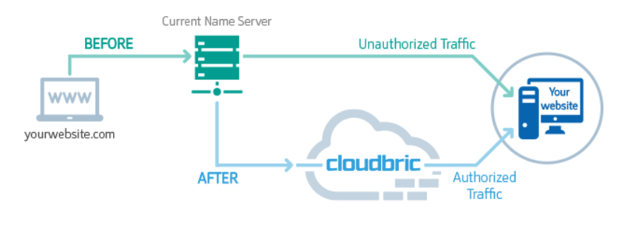
Cloudbric
Comprehensive web security
Web application firewall
DDoS protection
SSL Certificate

Slide 14
CONCLUSION
Development is along schedule with Sprint plan
Risk mitigation has been successful, development on Cloud9 for general collaboration
For the next Sprint we’ll be adapting our website to the PhoneGap Framework in order to have a nicer looking finished product

Slide 15
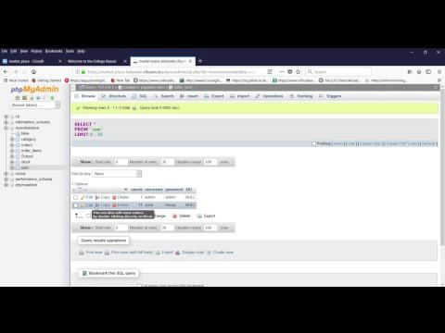
DEMO

